Slide 1

Department of CSE- Data Science
Mini Project Presentation
Project Name: Digital library
Presented By: Mohd Faizan Malik
Admission No: 2025B15430002
Date : 29/11/25

Slide 2

Content
Introduction
Problem Statement
Objectives
Methodology & Results
Conclusion & Future Work

Slide 3
INTRODUCTION
The "Online Book Reading" system is a web application designed to provide users with access to a digital library of books.
The platform aims to modernize the traditional book-buying and reading experience by bringing it online.
Key Focus:
User-friendly interface.
Accessible navigation (Home, Login, Signup, Contact).
A visually appealing catalog of books

Slide 4
PROBLEM STATEMENT
Current Challenges:
Physical Constraints: Traditional libraries and bookstores have limited physical stock and operating hours.
Accessibility: Readers often face difficulties finding specific titles in local stores.
Convenience: There is a lack of centralized platforms where users can browse, buy, and contact support in a single streamlined interface.
Proposed Solution:
A web portal that allows 24/7 access to browse book collections and manage user memberships

Slide 5
OBJECTIVES
Develop a Responsive UI: Create a clean, consistent user interface using HTML5 and CSS3.
User Management Interface: Design dedicated pages for user registration (Signup) and authentication (Login).
Product Display: Implement a "Card Layout" system to display book covers, descriptions, and pricing effectively.
Communication Channel: Establish a contact mechanism for user feedback and inquiries.

Slide 6
METHODOLOGY
Technologies Used:
HTML5: Used for the semantic structure of the application (Headers, Navigation, Forms, Footers).
CSS3: Used for styling, including:
Flexbox: For aligning navigation menus and book cards side-by-side.
Sticky Positioning: Keeping the navigation bar accessible while scrolling.
Hover Effects: Interactive buttons and links (Gold color on hover) to improve User Experience (UX)

Slide 7
Design Approach:
Modular Design: Reusable CSS classes (e.g., .container, .button, .nav) to ensure consistency across all pages.
Assets: Integration of high-quality imagery (via Unsplash) for book covers and hero sections.

Slide 8
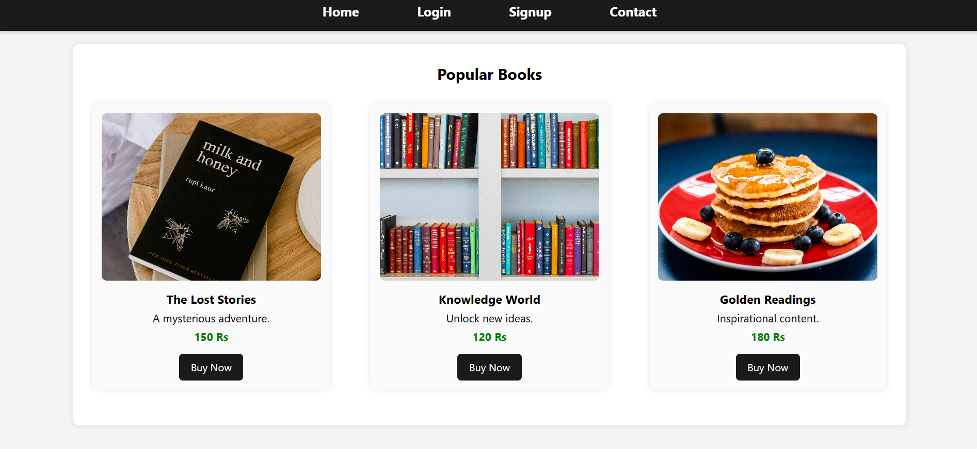
OUTPUTS

Slide 9
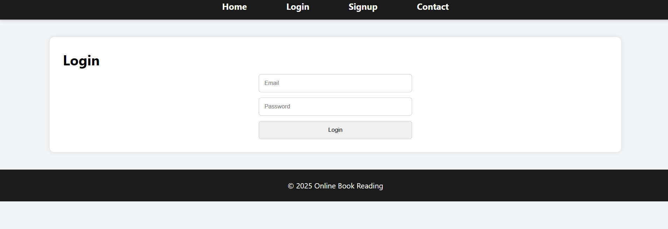
LOGIN PAGE

Slide 10
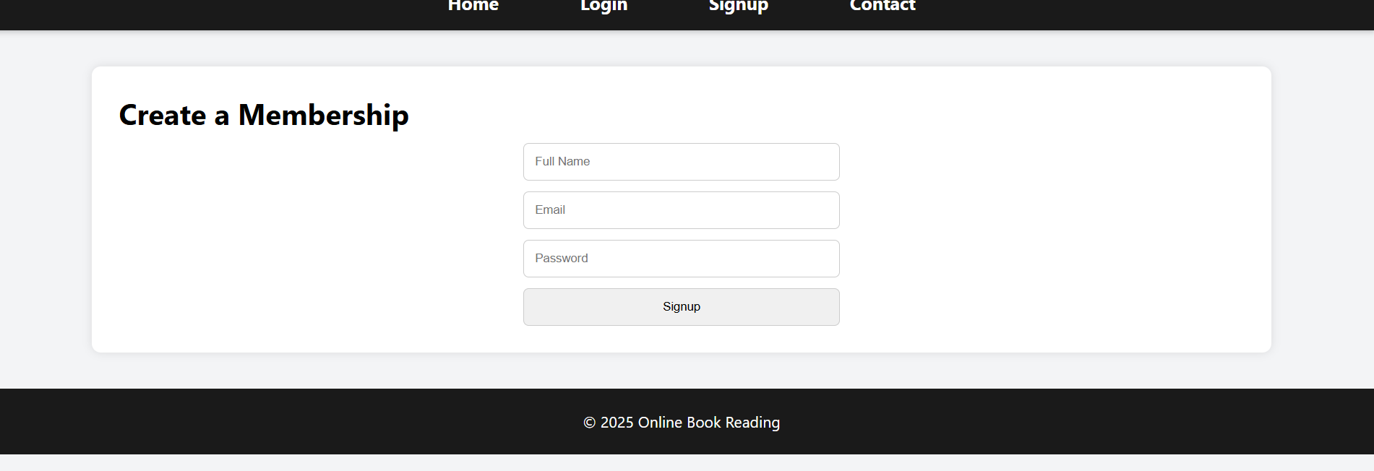
MEMBERSHIP PAGE

Slide 11
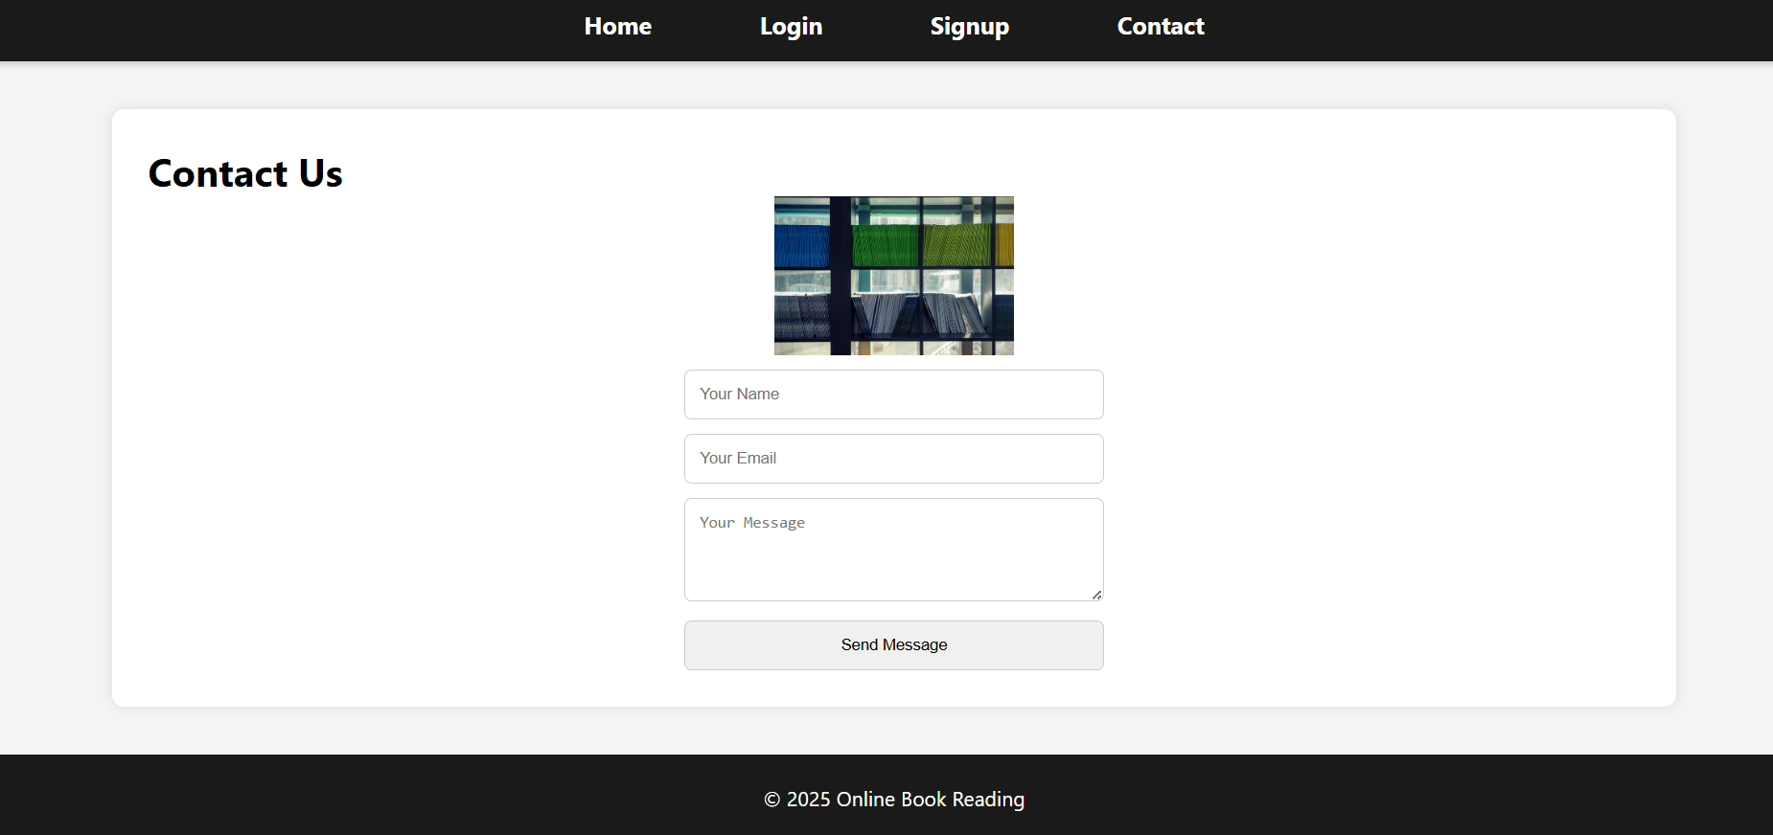
CONTACT US PAGE

Slide 12
CONCLUSION
Summary:
The project successfully demonstrates a functional Frontend Prototype for an online bookstore.
All core navigation links works seamlessly between Home, Login, Signup, and Contact pages.
The visual hierarchy (Navigation -> Header -> Content -> Footer) is maintained consistently across the application.
Impact:
Provides a strong foundation for a scalable e-commerce or e-library application

Slide 13
FUTURE WORK
Backend Integration: Connect the HTML forms to a server (Node.js/PHP) and Database (SQL/MongoDB) to store user data and actual book content.
Payment Gateway: Implement functionality for the "Buy Now" buttons to process real transactions.
Search Functionality: Add a search bar to filter books by title or genre.
Responsiveness: Further refine CSS media queries to ensure perfect rendering on mobile devices.

Slide 14
Thank You

